Slide 1

COMP 520 - Compilers
Lecture 16 – Code/Data Path Analysis

Slide 2
Reminders
If you submitted PA3 late, make a private post on Piazza so we can determine an appropriate grade.
Submit to Partial tests, and your first submission to Hidden tests implies you need a grade.
Midterm 2 on next Thursday, 4/11
COMP 520: Compilers – S. Ali

Slide 3
Reminders (2)
As of Lec 15, you have everything you need to do PA4.
Start sooner rather than later.
Midterm 2 on next Thursday, 4/11
COMP 520: Compilers – S. Ali

Slide 4

Compiler
Optimization
Dataflow Analysis
Code Analysis
Data Liveness
Expr Liveness
Register Minimalization
Multiple CodePath
Generation
TODAY
COMP 520: Compilers – S. Ali

Slide 5





Compilers are magic
This phrase is humorous.
For the compiler developer, not so much.
What exactly is so magical about a compiler?
  It has the ability to nearly ignore how the programmer wrote code, and instead does something equivalent and more optimized. (not always a good thing)
COMP 520: Compilers – S. Ali

Slide 6
Today
Data and Expression Liveness analysis
Algorithms to analyze data usage and memory dependencies
Goal
Reduce memory usage and instruction count.
COMP 520: Compilers – S. Ali

Slide 7
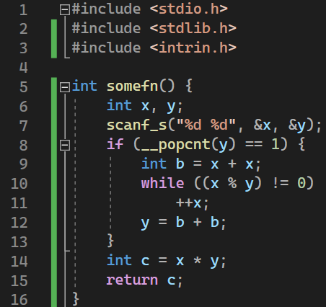
Motivation
Variable b and c are never
used at the same time
Can save space by not keeping both in memory
COMP 520: Compilers – S. Ali

Slide 8
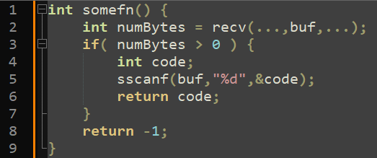
Motivation (2)
We have two int variables, but after line 3, numBytes is never used again
Ask the developer to change the code?
COMP 520: Compilers – S. Ali

Slide 9
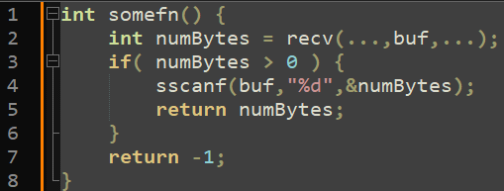
Motivation (3)
Old
But we now have a problem, the variable name “numBytes” does not actually describe its function
To support good coding practices, we will need to solve how to reduce memory consumption without asking the developer to change their programming habits.
New
COMP 520: Compilers – S. Ali

Slide 10
Problem Statement
Programmers create variables whenever.
They do not want to reuse variables that are available.
On limited compute capacity machines, we cannot afford to waste memory.
COMP 520: Compilers – S. Ali

Slide 11
Scoped Data Liveness
A suboptimal but simple solution.
COMP 520: Compilers – S. Ali

Slide 12
Scoped Data Liveness
Recall: when a local variable is declared,
create stack space for it (simple PA4, Lec14-15)
Idea: whenever a scope closes, reclaim stack space.
COMP 520: Compilers – S. Ali

Slide 13
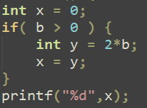
Scoped Data Liveness (2)
Idea: whenever a scope closes, reclaim stack space.
Code Gen
push 0 # Create Stack Space &x = rbp-8
…
RIP
COMP 520: Compilers – S. Ali

Slide 14
Scoped Data Liveness (3)
Idea: whenever a scope closes, reclaim stack space.
push 0 # Create Stack Space &x = rbp-8
…
push 0 # Create &y = rbp-16
Code Gen
RIP
COMP 520: Compilers – S. Ali

Slide 15
Scoped Data Liveness (4)
Idea: whenever a scope closes, reclaim stack space.
push 0 # Create Stack Space &x = rbp-8
…
push 0 # Create &y = rbp-16
mov rax, 2
imul [b]
mov [y],rax
add rsp,8 # Reclaim y’s space
RIP
Code Gen
COMP 520: Compilers – S. Ali

Slide 16
Scoped Data Liveness – Not Optimal
Why is this not enough?
COMP 520: Compilers – S. Ali

Slide 17
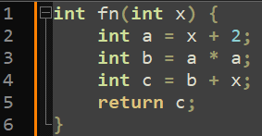
Scoped Data Liveness – Counterexample
At this point, variable a is no longer used.
Thus, some other strategy can be better.
COMP 520: Compilers – S. Ali

Slide 18
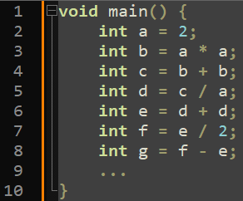
When you have really long methods..
If the programmer writes bad code, then sure, we have no obligation to make sure it runs.
But you can’t dictate programming habits, and what if some methods just end up being very complicated?
Also, we would want our compiler to work even if others don’t.
COMP 520: Compilers – S. Ali

Slide 19
Scoped Data Liveness Overview
Overview:
Reclaim stack space when a scope ends.
Not optimal (too coarse-grain).
In PA4: expected to clean up the stack to some degree, and scoped liveness fulfills that requirement.
We now study better techniques.
COMP 520: Compilers – S. Ali

Slide 20
Definition: Live Variable
Let’s formalize data liveness.
A variable x is live before an instruction if x is assigned a value before that point, and an instruction will use x after that point.
Liveness is overloaded. Liveness also refers to ensuring lock requests are eventually satisfied.
Instead, we call it Data Liveness, which is
a part of Dataflow Analysis.
Defn.
COMP 520: Compilers – S. Ali

Slide 21
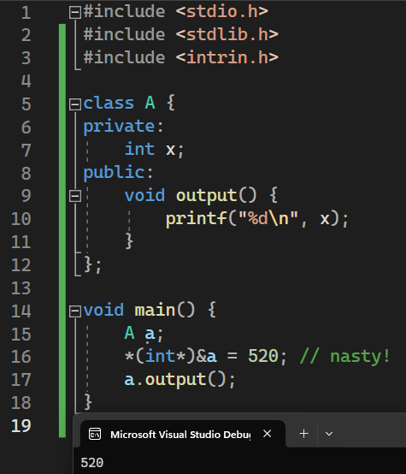
Optimality Concerns
Data Liveness Analysis may overly designate variables as “live”.
Better than the opposite.
Very difficult in some languages.
Example: access variables by memory offsets.
Output:
COMP 520: Compilers – S. Ali

Slide 22
Control Flow Graphs (CFGs)
A super unfortunate acronym.
CFG in parsing is context-free grammar.
CFG in code generation is a control flow graph.
COMP 520: Compilers – S. Ali

Slide 23
Basic Control Flow Graph
AssignStmt
CallStmt
WhileStmt
AssignStmt
ReturnStmt
COMP 520: Compilers – S. Ali

Slide 24
Exploded Flow Graph
AssignStmt
AssignStmt
CallStmt
WhileStmt
Fall-Through
Edges
CallStmt
WhileStmt
AssignStmt
ReturnStmt
AssignStmt
ReturnStmt
COMP 520: Compilers – S. Ali

Slide 25

CFG Edges
Vertex $≡$ Operation
(Instruction/Concrete AST)
In-Edge $≡$ Directed edge going to the vertex
Out-Edge $≡$ Directed edge going out of the vertex
Successor/Predecessor $≡$ All vertices connected by an out/in-edge
Def: in($v$) $≡$ Set of all variables live at In-Edges (before vertex $v$)
Def: out($v$) $≡$ Set of all variables live at Out-Edges (after vertex $v$)
In-Edges
Operation
Defn.
Out-Edges
COMP 520: Compilers – S. Ali

Slide 26
Define Data Liveness at Edges
(before and after)
Consider a motivating example:
int x = y + 1
(Assume y never used again)
So both x and y can use:
[rbp-8]
COMP 520: Compilers – S. Ali

Slide 27
Define Data Liveness at Edges (2)
Live: { y }
Construct CFG
Consider a motivating example:
int x = y + 1
(y never used again)
So both x and y can use:
[rbp-8]
?? | tmp := y
Live: { tmp }
?? | tmp:= tmp+1
Note the addition of “temp” variables. This is a part of Dataflow Analysis.
Live: { tmp }
?? | x := tmp
Live: { x }
COMP 520: Compilers – S. Ali

Slide 28

Define Data Liveness at Edges (3)
Live: { y }
Generate Code
Consider a motivating example:
int x = y + 1
(y never used again)
So both x and y will use:
[rbp-8]
mov rax,[rbp-8] | rax := y
Live: { rax }
inc rax | rax := rax + 1
Temporary variables will turn into registers eventually.
Live: { rax }
mov [rbp-8],rax | x := rax
Live: { x }
COMP 520: Compilers – S. Ali

Slide 29

Can visually see it, but how can we detect such optimizations?
…We will need more tools!
mov rax,[rbp-8] | rax := y
inc rax | rax := rax + 1
mov [rbp-8],rax | x := rax
$$≡$$
inc [rbp-8] | x := y + 1
Don’t worry about such optimizations until you are done with PA4
COMP 520: Compilers – S. Ali

Slide 30
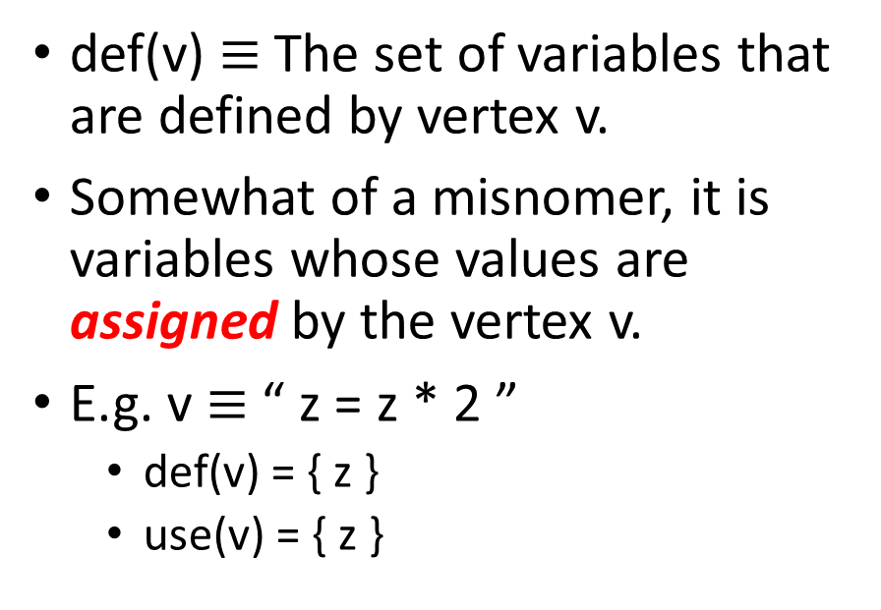
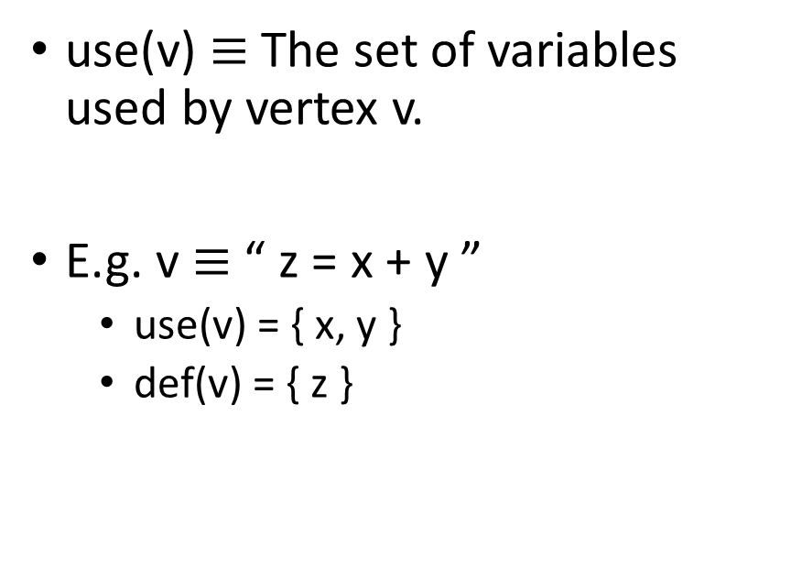
More Definitions
Set: use(v)
Set: def(v)
use(v) $≡$ The set of variables used by vertex v.
E.g. v $≡$ “ z = x + y ”
  use(v) = { x, y }
  def(v) = { z }
def(v) $≡$ The set of variables that are defined by vertex v.
Somewhat of a misnomer, it is variables whose values are assigned by the vertex v.
E.g. v $≡$ “ z = z * 2 ”
  def(v) = { z }
  use(v) = { z }
COMP 520: Compilers – S. Ali

Slide 31
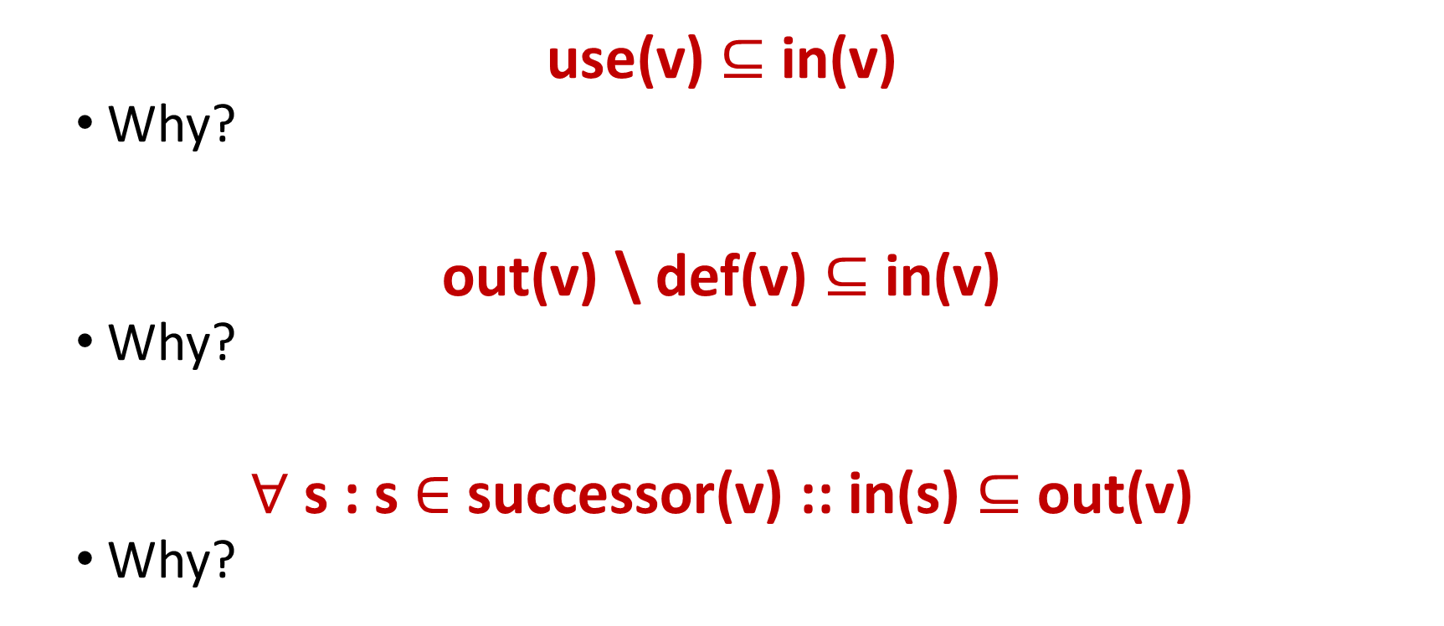

Constraints
$$∀v : v∈V ∷$$
use(v) $⊆$ in(v)
  Why?
out(v) \ def(v) $⊆$ in(v)
  Why?
$∀$ s : s $∈$ successor(v) :: in(s) $⊆$ out(v)
  Why?
COMP 520: Compilers – S. Ali

Slide 32
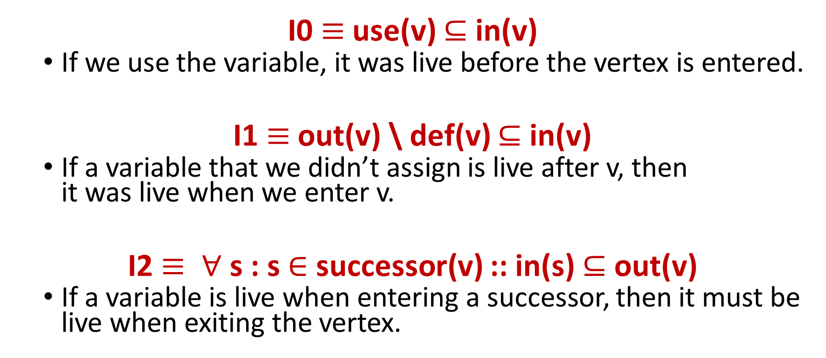
Constraints (2)
$$∀v : v∈V ∷$$
I0 $≡$use(v) $⊆$ in(v)
  If we use the variable, it was live before the vertex is entered.
I1 $≡$out(v) \ def(v) $⊆$ in(v)
  If a variable that we didn’t assign is live after v, then
  it was live when we enter v.
I2 $≡ ∀$ s : s $∈$ successor(v) :: in(s) $⊆$ out(v)
  If a variable is live when entering a successor, then it must be live when exiting the vertex.
COMP 520: Compilers – S. Ali

Slide 33
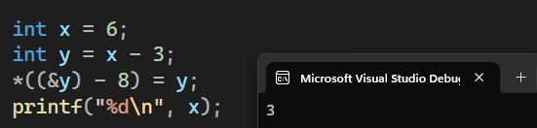
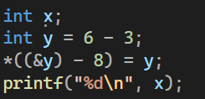
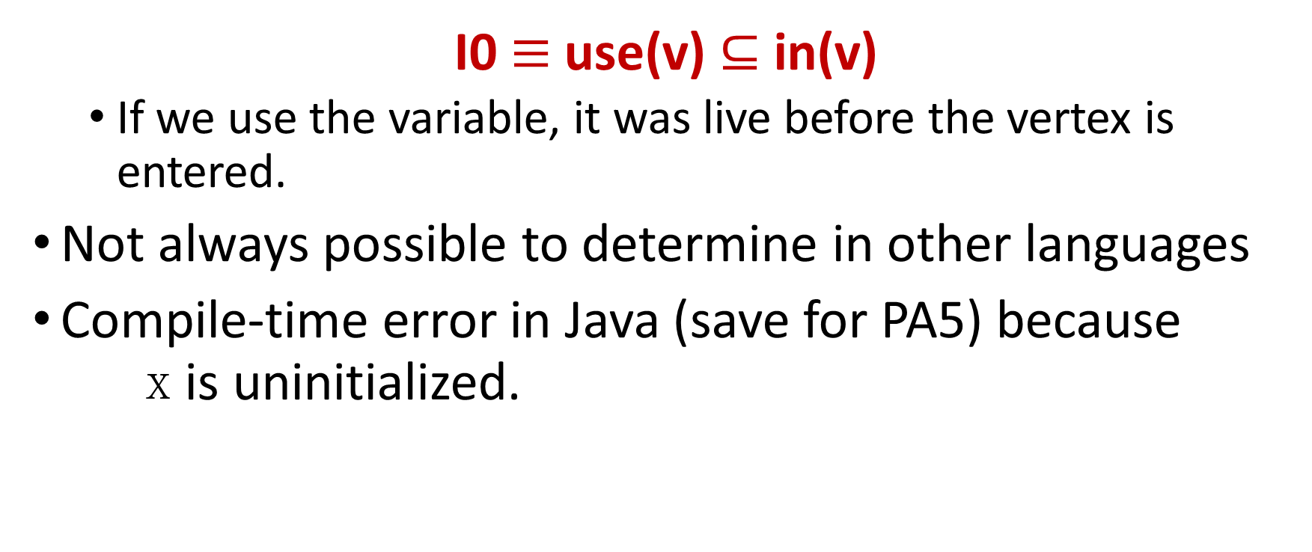
Other Languages
$$∀v : v∈V ∷$$
I0 $≡$use(v) $⊆$ in(v)
  If we use the variable, it was live before the vertex is entered.
Not always possible to determine in other languages
Compile-time error in Java (save for PA5) because
x is uninitialized.
COMP 520: Compilers – S. Ali

Slide 34
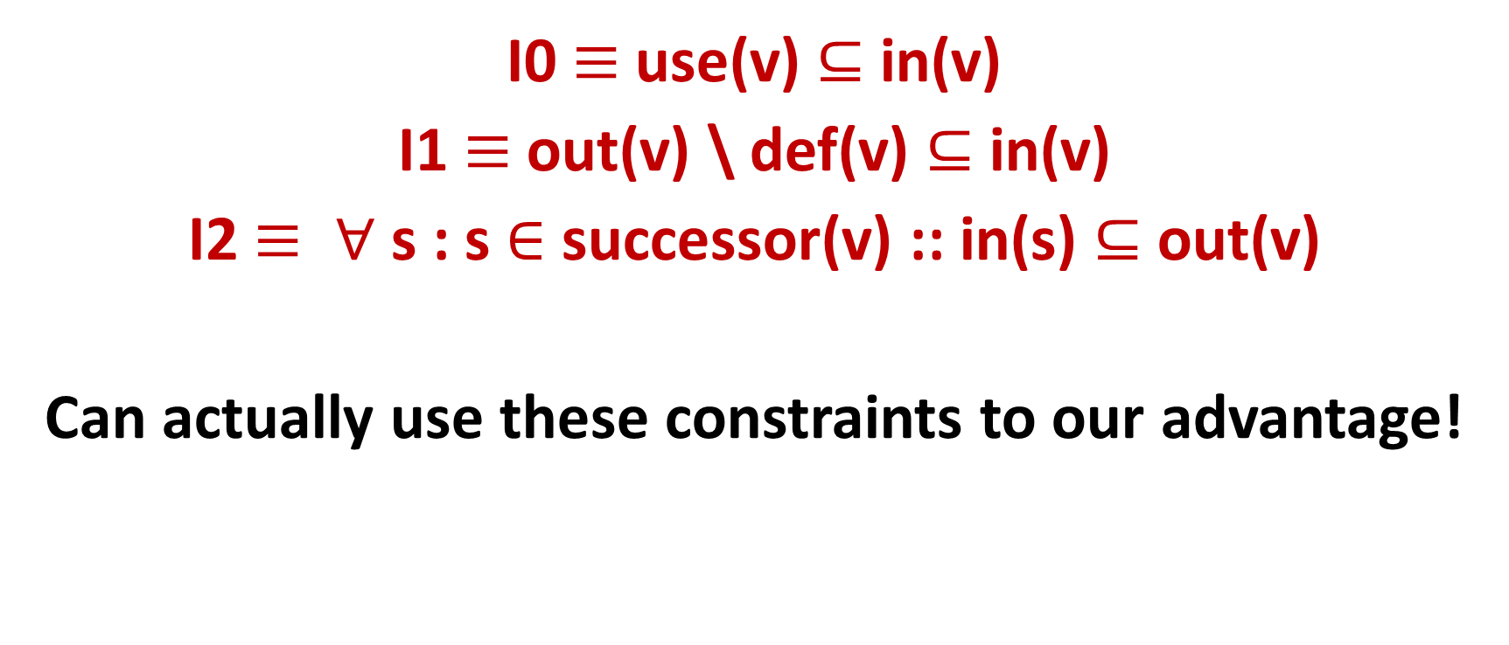
Goal
$$∀v : v∈V ∷$$
I0 $≡$use(v) $⊆$ in(v)
I1 $≡$out(v) \ def(v) $⊆$ in(v)
I2 $≡ ∀$ s : s $∈$ successor(v) :: in(s) $⊆$ out(v)
Can actually use these constraints to our advantage!
COMP 520: Compilers – S. Ali

Slide 35
Iterative Data Liveness Analysis
COMP 520: Compilers – S. Ali

Slide 36
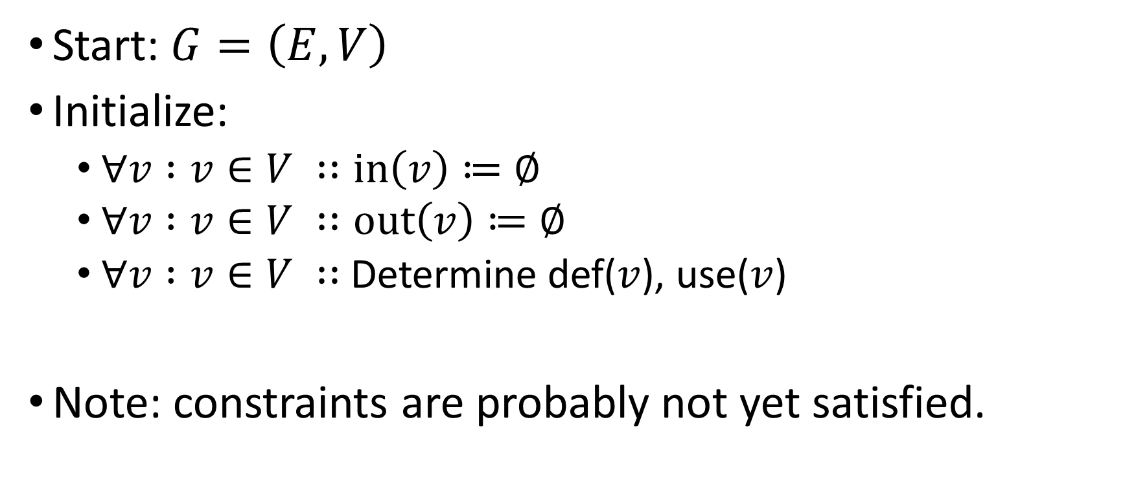
Initialization (Base Case)
Start: $G=\left(E,V\right)$
Initialize:
  $∀v :v∈V ∷in\left(v\right)≔∅$
  $∀v :v∈V ∷out\left(v\right)≔∅$
  $∀v :v∈V ∷$Determine def($v$), use($v$)
Note: constraints are probably not yet satisfied.
COMP 520: Compilers – S. Ali

Slide 37
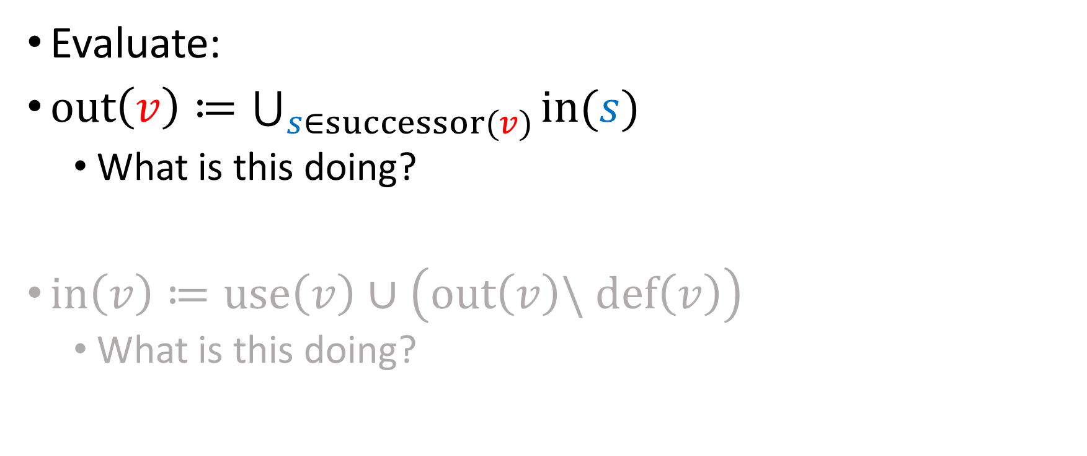
Iterative Step
Evaluate:
$out\left(v\right)≔\bigcup_{s∈successor(v)}{in(s)}$
  What is this doing?
$in\left(v\right)≔use\left(v\right)∪\left(out\left(v\right)\backslash def\left(v\right)\right)$
  What is this doing?
COMP 520: Compilers – S. Ali

Slide 38
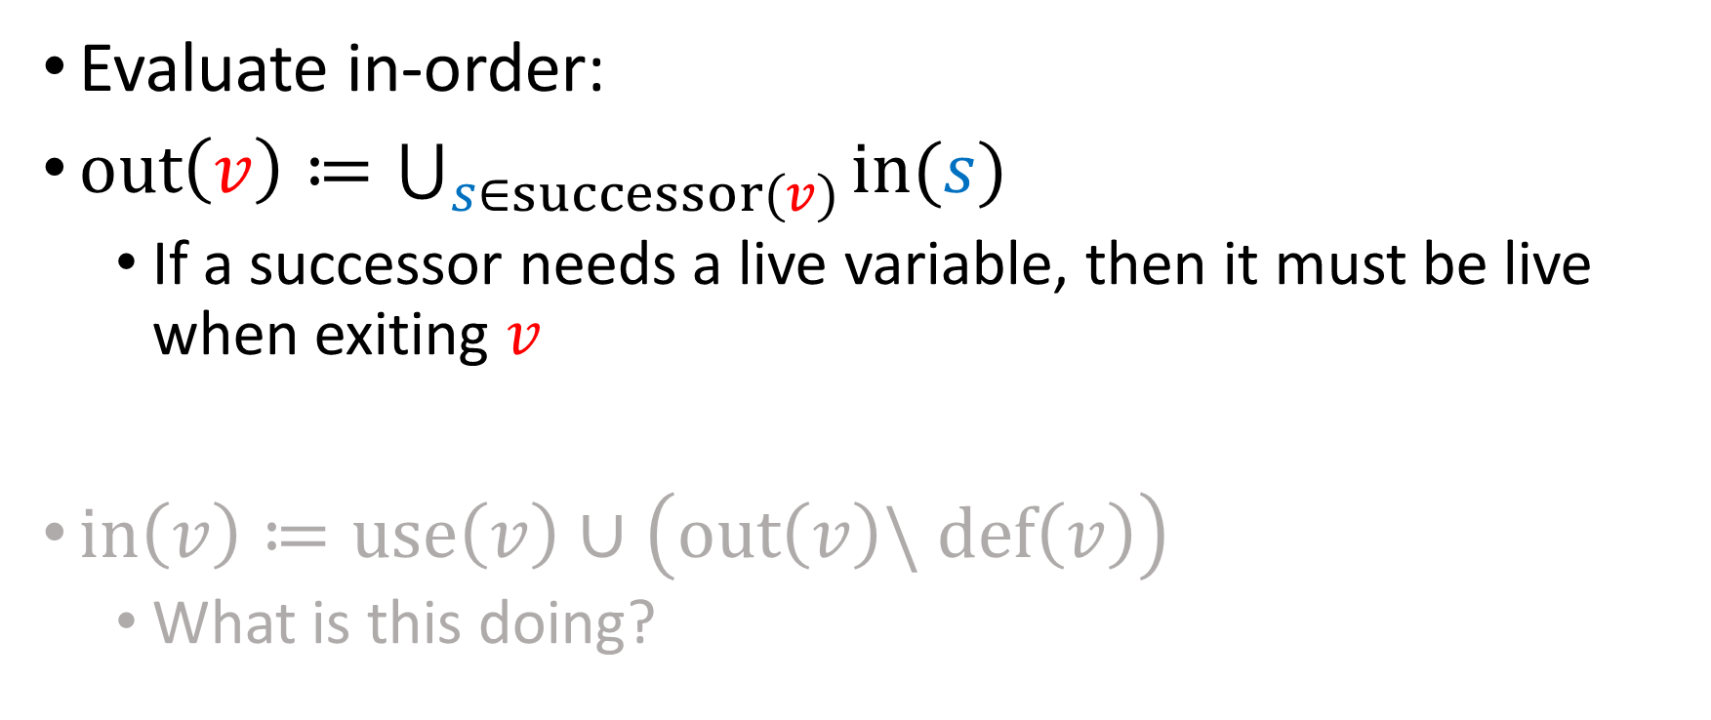
Iterative Step (2)
Evaluate in-order:
$out\left(v\right)≔\bigcup_{s∈successor(v)}{in(s)}$
  If a successor needs a live variable, then it must be live when exiting $v$
$in\left(v\right)≔use\left(v\right)∪\left(out\left(v\right)\backslash def\left(v\right)\right)$
  What is this doing?
COMP 520: Compilers – S. Ali

Slide 39

Iterative Step (3)
$out\left(v\right)≔\bigcup_{s∈successor(v)}{in(s)}$
$in\left(v\right)≔use\left(v\right)∪\left(out\left(v\right)\backslash def\left(v\right)\right)$
  What is this doing?
COMP 520: Compilers – S. Ali

Slide 40
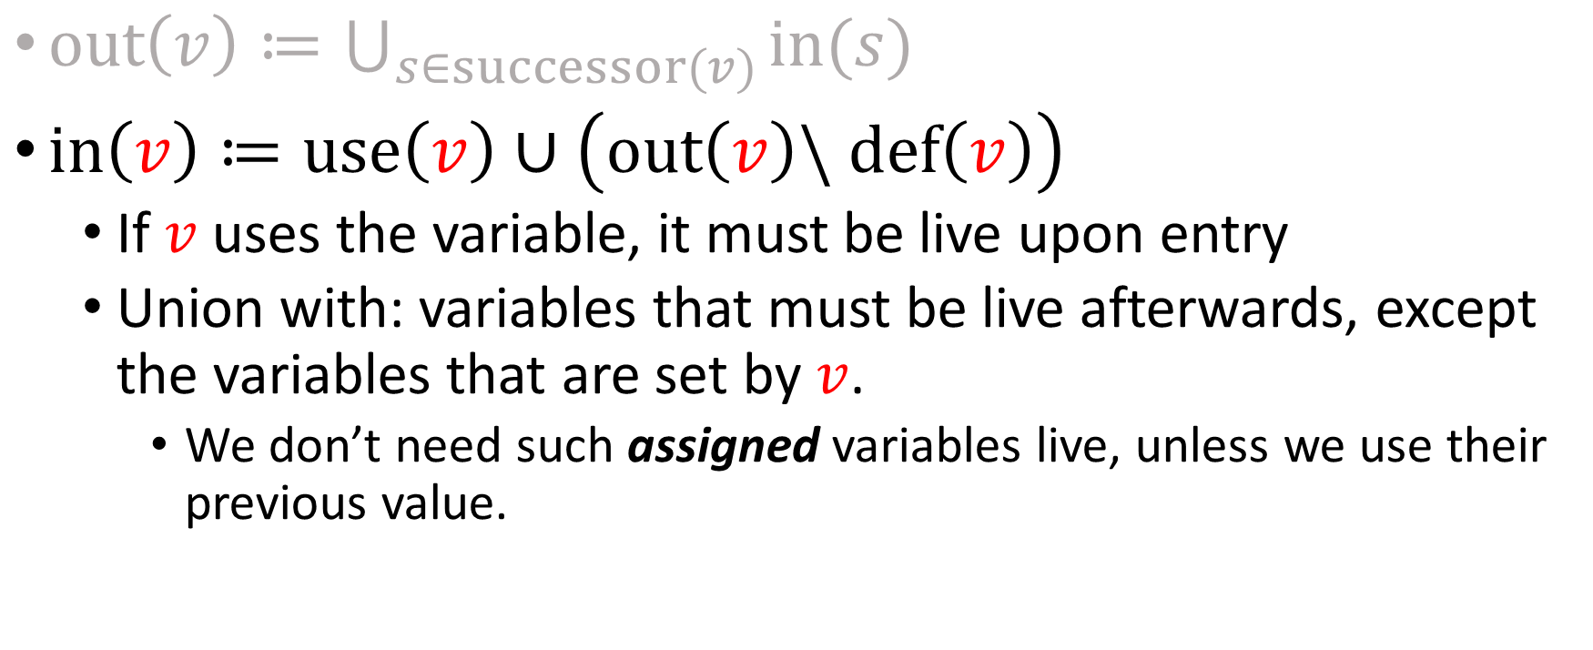
Iterative Step (4)
$out\left(v\right)≔\bigcup_{s∈successor(v)}{in(s)}$
$in\left(v\right)≔use\left(v\right)∪\left(out\left(v\right)\backslash def\left(v\right)\right)$
  If $v$ uses the variable, it must be live upon entry
  Union with: variables that must be live afterwards, except the variables that are set by $v$.
    We don’t need such assigned variables live, unless we use their previous value.
COMP 520: Compilers – S. Ali

Slide 41
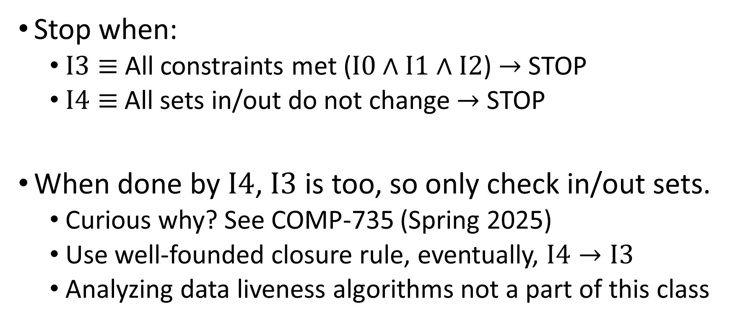
Fixed-Point
Stop when:
  $I3≡$ All constraints met ($I0∧I1∧I2$) $→$ STOP
  $I4≡$All sets in/out do not change $→$ STOP
When done by $I4$, $I3$ is too, so only check in/out sets.
  Curious why? See COMP-735 (Spring 2025)
  Use well-founded closure rule, eventually, $I4→I3$
  Analyzing data liveness algorithms not a part of this class
COMP 520: Compilers – S. Ali

Slide 42
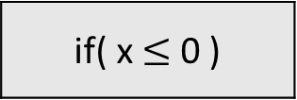
Example:
if( x $≤$ 0 )
y = w + 1
y = 0; x = 10; z = 2; w = 0;
while( x > 0 ) {
y = w + 1;
x = x – 1;
z = 2 * z;
w = z / y;
}
return y;
x = x - 1
z = 2 * z
w = z / y;
return y
COMP 520: Compilers – S. Ali

Slide 43

Initialization.
in:
if( x $≤$ 0 )
out:
use: x
in:
y = w + 1
Determine sets: use/def
Assign all in/out to $∅$
out:
u: w
def: y
in:
x = x - 1
use: x
def: x
out:
in:
z = 2 * z
use: z
def: z
out:
in:
w = z / y;
u: z, y
d: w
out:
in:
return y
use: y
COMP 520: Compilers – S. Ali

Slide 44
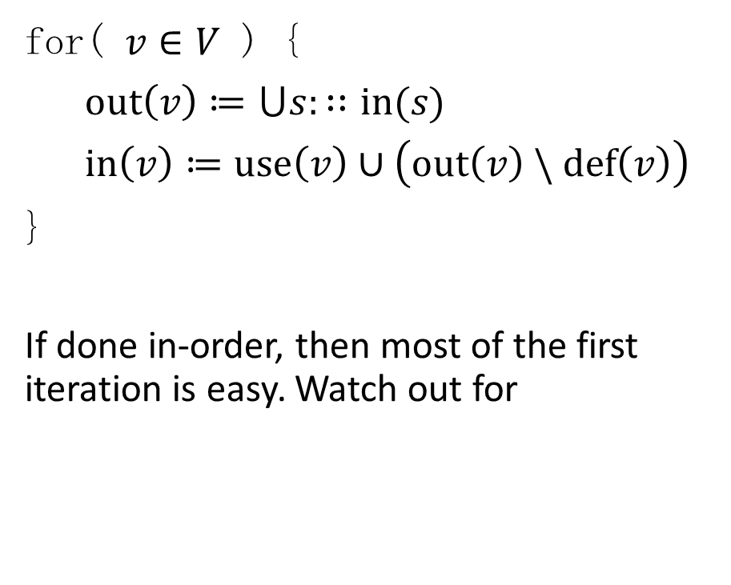
Iteration 1
x
if( x $≤$ 0 )
use: x
w
y = w + 1
for( $v∈V$ ) {
$out\left(v\right)≔⋃s:∷in(s)$
$in\left(v\right)≔use\left(v\right)∪\left(out\left(v\right) \backslash def\left(v\right)\right)$
}
If done in-order, then most of the first iteration is easy. Watch out for
u: w
def: y
x
x = x - 1
use: x
def: x
z
z = 2 * z
use: z
def: z
x, y, z
w = z / y;
u: z, y
d: w
x
y
return y
use: y
COMP 520: Compilers – S. Ali

Slide 45
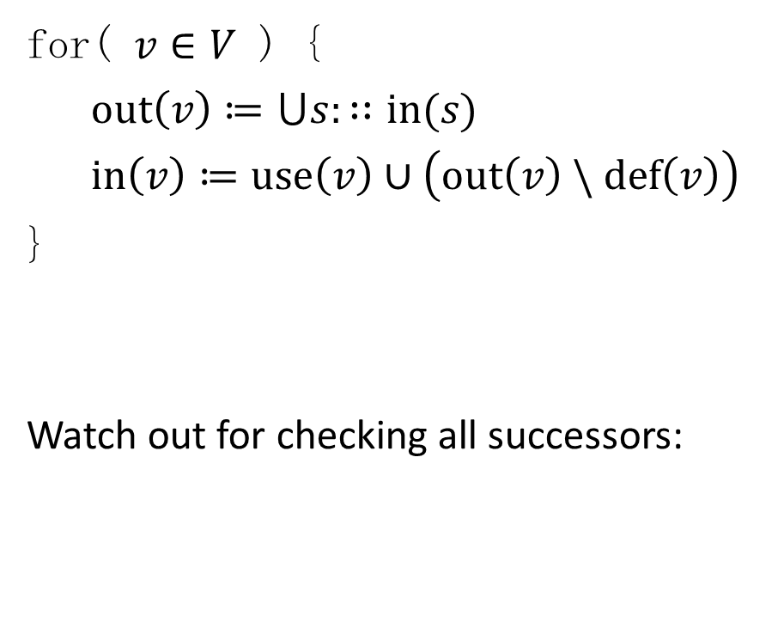
Iteration 2
w, x, y
if( x $≤$ 0 )
w, y
use: x
w
y = w + 1
for( $v∈V$ ) {
$out\left(v\right)≔⋃s:∷in(s)$
$in\left(v\right)≔use\left(v\right)∪\left(out\left(v\right) \backslash def\left(v\right)\right)$
}
Watch out for checking all successors:
u: w
def: y
x
x = x - 1
use: x
def: x
z
z = 2 * z
use: z
def: z
x, y, z
w = z / y;
u: z, y
d: w
x
y
return y
use: y
COMP 520: Compilers – S. Ali

Slide 46

Iteration 2 (2)
w, x, y
if( x $≤$ 0 )
w, y
use: x
w, x
y = w + 1
for( $v∈V$ ) {
$out\left(v\right)≔⋃s:∷in(s)$
$in\left(v\right)≔use\left(v\right)∪\left(out\left(v\right) \backslash def\left(v\right)\right)$
}
x
u: w
def: y
x
x = x - 1
use: x
def: x
z
z = 2 * z
use: z
def: z
x, y, z
w = z / y;
u: z, y
d: w
x
y
return y
use: y
COMP 520: Compilers – S. Ali

Slide 47
Iteration 2 (3)
w, x, y
if( x $≤$ 0 )
w, y
use: x
w, x
y = w + 1
for( $v∈V$ ) {
$out\left(v\right)≔⋃s:∷in(s)$
$in\left(v\right)≔use\left(v\right)∪\left(out\left(v\right) \backslash def\left(v\right)\right)$
}
x
u: w
def: y
x, z
x = x - 1
use: x
def: x
z
z
z = 2 * z
use: z
def: z
x, y, z
w = z / y;
u: z, y
d: w
x
y
return y
use: y
COMP 520: Compilers – S. Ali

Slide 48
Iteration 2 (4)
w, x, y
if( x $≤$ 0 )
w, y
use: x
w, x
y = w + 1
for( $v∈V$ ) {
$out\left(v\right)≔⋃s:∷in(s)$
$in\left(v\right)≔use\left(v\right)∪\left(out\left(v\right) \backslash def\left(v\right)\right)$
}
x
u: w
def: y
x, z
x = x - 1
use: x
def: x
z
x, y, z
z = 2 * z
use: z
def: z
x, y, z
x, y, z
w = z / y;
u: z, y
d: w
x
y
return y
use: y
COMP 520: Compilers – S. Ali

Slide 49

Iteration 2 (5)
w, x, y
if( x $≤$ 0 )
w, y
use: x
w, x
y = w + 1
for( $v∈V$ ) {
$out\left(v\right)≔⋃s:∷in(s)$
$in\left(v\right)≔use\left(v\right)∪\left(out\left(v\right) \backslash def\left(v\right)\right)$
}
Note: no change here
x
u: w
def: y
x, z
x = x - 1
use: x
def: x
z
x, y, z
z = 2 * z
use: z
def: z
x, y, z
x, y, z
w = z / y;
u: z, y
d: w
w, x, y
y
return y
use: y
COMP 520: Compilers – S. Ali

Slide 50
Iteration 3
w, x, y
if( x $≤$ 0 )
w, x, y
use: x
w, x, z
y = w + 1
for( $v∈V$ ) {
$out\left(v\right)≔⋃s:∷in(s)$
$in\left(v\right)≔use\left(v\right)∪\left(out\left(v\right) \backslash def\left(v\right)\right)$
}
x, z
u: w
def: y
x, y, z
x = x - 1
use: x
def: x
x, y, z
x, y, z
z = 2 * z
use: z
def: z
x, y, z
x, y, z
w = z / y;
u: z, y
d: w
w, x, y
y
return y
use: y
COMP 520: Compilers – S. Ali

Slide 51
Iteration 4
w, x, y, z
if( x $≤$ 0 )
w, x, y, z
use: x
w, x, z
y = w + 1
for( $v∈V$ ) {
$out\left(v\right)≔⋃s:∷in(s)$
$in\left(v\right)≔use\left(v\right)∪\left(out\left(v\right) \backslash def\left(v\right)\right)$
}
x, y, z
u: w
def: y
x, y, z
x = x - 1
use: x
def: x
x, y, z
x, y, z
z = 2 * z
use: z
def: z
x, y, z
x, y, z
w = z / y;
u: z, y
d: w
w, x, y, z
y
return y
use: y
COMP 520: Compilers – S. Ali

Slide 52
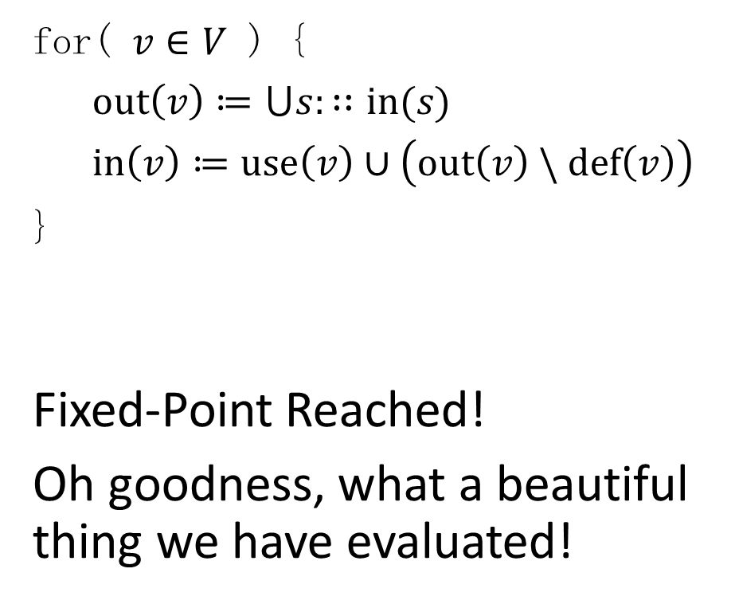
Iteration 5
w, x, y, z
if( x $≤$ 0 )
w, x, y, z
use: x
w, x, z
y = w + 1
for( $v∈V$ ) {
$out\left(v\right)≔⋃s:∷in(s)$
$in\left(v\right)≔use\left(v\right)∪\left(out\left(v\right) \backslash def\left(v\right)\right)$
}
Fixed-Point Reached!
Oh goodness, what a beautiful thing we have evaluated!
x, y, z
u: w
def: y
x, y, z
x = x - 1
use: x
def: x
x, y, z
x, y, z
z = 2 * z
use: z
def: z
x, y, z
x, y, z
w = z / y;
u: z, y
d: w
w, x, y, z
y
return y
use: y
COMP 520: Compilers – S. Ali

Slide 53
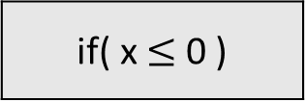
w, x, y, z
if( x $≤$ 0 )
Observation 1.
Parts of the code exist where variable “w” is not needed
w, x, y, z
use: x
w, x, z
y = w + 1
x, y, z
u: w
def: y
x, y, z
x = x - 1
use: x
def: x
x, y, z
x, y, z
z = 2 * z
use: z
def: z
x, y, z
x, y, z
w = z / y;
u: z, y
d: w
w, x, y, z
y
return y
use: y
COMP 520: Compilers – S. Ali

Slide 54
LIFETIME
w | x | y | z
w, x, y, z
if( x $≤$ 0 )
Shown:
Data lifetime Graph
No lifetimes are disjoint.
w, x, y, z
use: x
w, x, z
y = w + 1
x, y, z
u: w
def: y
x, y, z
x = x - 1
use: x
def: x
x, y, z
x, y, z
z = 2 * z
use: z
def: z
x, y, z
x, y, z
w = z / y;
u: z, y
d: w
w, x, y, z
y
return y
use: y
COMP 520: Compilers – S. Ali

Slide 55
LIFETIME
w | x | y | z | e
if( x $≤$ 0 )
w, x, y, z
Consider the modifications in yellow.
Note the disjoint lifetime of e and w.
w, x, y, z
use: x
y = w + 1
w, x, z
u: w
def: y
x, y, z
x = x - 1
x, y, z
use: x
def: x
x, y, z
x, y, z
int e = 2
use:
def: e
x, y, z, e
x, y, z, e
z = e * z
u: e, z
def: z
x, y, z
x, y, z
w = z / y;
u: z, y
d: w
w, x, y, z
y
return y
use: y
COMP 520: Compilers – S. Ali

Slide 56

This is a similar, earlier problem
y = 0; x = 10; z = 2; w = 0;
while( x > 0 ) {
y = w + 1;
x = x – 1;
int e = 2;
z = e * z;
w = z / y;
}
return y;
y = 0; x = 10; z = 2; w = 0;
while( x > 0 ) {
y = w + 1;
x = x – 1;
w = 2;
z = w * z;
w = z / y;
}
return y;
EQUIV.
COMP 520: Compilers – S. Ali

Slide 57
How many variables are needed?
Variables: 5
Concurrently Alive: 4
y = 0; x = 10; z = 2; w = 0;
while( x > 0 ) {
y = w + 1;
x = x – 1;
int e = 2;
z = e * z;
w = z / y;
}
return y;
Variables: 4
Concurrently Alive: 4
y = 0; x = 10; z = 2; w = 0;
while( x > 0 ) {
y = w + 1;
x = x – 1;
w = 2;
z = w * z;
w = z / y;
}
return y;
EQUIV.
COMP 520: Compilers – S. Ali

Slide 58
Primary Observation
y = 0; x = 10;
z = 2; w = 0;
while( x > 0 ) {
y = w + 1;
x = x – 1;
int e = 2;
z = e * z;
w = z / y;
}
return y;
Variables with disjoint lifetimes can utilize the same memory space.
Thus, the code in the earlier example can be done using 4 registers.
Question: can we keep everything in registers and commit w, x, y, z after the loop ends?
COMP 520: Compilers – S. Ali

Slide 59
Side Observation - Multithreaded
Question: can we keep everything in registers and commit w, x, y, z after the loop ends?
Only if your target machine has no concurrent threads accessing the memory of w, x, y, z (e is a local, but the other variables could have been global)
Multi-threaded dataflow analysis is possible. Very helpful when using OpenMP/CUDA/barriers/fences. Optimization is huge.
  Seen in COMP-735, but in the context of program states and transactions. Also in COMP-633, but not sure when it is offered next.
Need implicit or explicit commit points for proper analysis
COMP 520: Compilers – S. Ali

Slide 60
Available Expressions / Expression Lifetime Analysis
Can also apply lifetime analysis to expressions, not just variables.
COMP 520: Compilers – S. Ali

Slide 61
Consider the following code:
s := a + b;
m := a * b;
while( m > a ) {
a := a + 1;
s := a + b;
}
COMP 520: Compilers – S. Ali

Slide 62
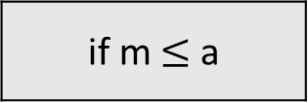
Construct the CFG
s := a + b
s := a + b;
m := a * b;
while( m > a ) {
a := a + 1;
s := a + b;
}
m := a * b
if m $≤$ a
a := a + 1
return
s := a + b
COMP 520: Compilers – S. Ali

Slide 63
When data is invalidated, so are all expressions utilizing that data.
s := a + b
s := a + b;
m := a * b;
while( m > a ) {
a := a + 1;
s := a + b;
}
{ a+b }
m := a * b
{ a+b, a*b }
if m $≤$ a
{ a+b, a*b }
{ a+b, a*b }
a := a + 1
return
s := a + b
COMP 520: Compilers – S. Ali

Slide 64
When data is invalidated, so are all expressions utilizing that data.
s := a + b
s := a + b;
m := a * b;
while( m > a ) {
a := a + 1;
s := a + b;
}
Note: we lost a*b here:
{ a+b }
m := a * b
{ a+b, a*b }
if m $≤$ a
{ a+b }
??
a := a + 1
return
{ }
s := a + b
{ a+b }
COMP 520: Compilers – S. Ali

Slide 65
When data is invalidated, so are all expressions utilizing that data.
s := a + b
s := a + b;
m := a * b;
while( m > a ) {
a := a + 1;
s := a + b;
}
{ a+b }
m := a * b
{ a+b, a*b }
if m $≤$ a
{ a+b }
{ a+b }
a := a + 1
return
{ }
s := a + b
{ a+b }
COMP 520: Compilers – S. Ali

Slide 66
Expression Liveness
Very useful so that an expression does not have to be re-evaluated.
Let’s look at that example earlier with one minor modification.
COMP 520: Compilers – S. Ali

Slide 67

No need to re-evaluate a+b, because s is an alias.
s := a + b
s := a + b;
m := a * b;
while( m > a ) {
a := a + 1;
s := a + b;
}
z := a + b;
{ a+b }
m := a * b
{ a+b, a*b }
if m $≤$ a
{ a+b }
{ a+b }
a := a + 1
z = a + b
Evaluate a+b?? NO!
{ }
s := a + b
return
{ a+b }
COMP 520: Compilers – S. Ali

Slide 68
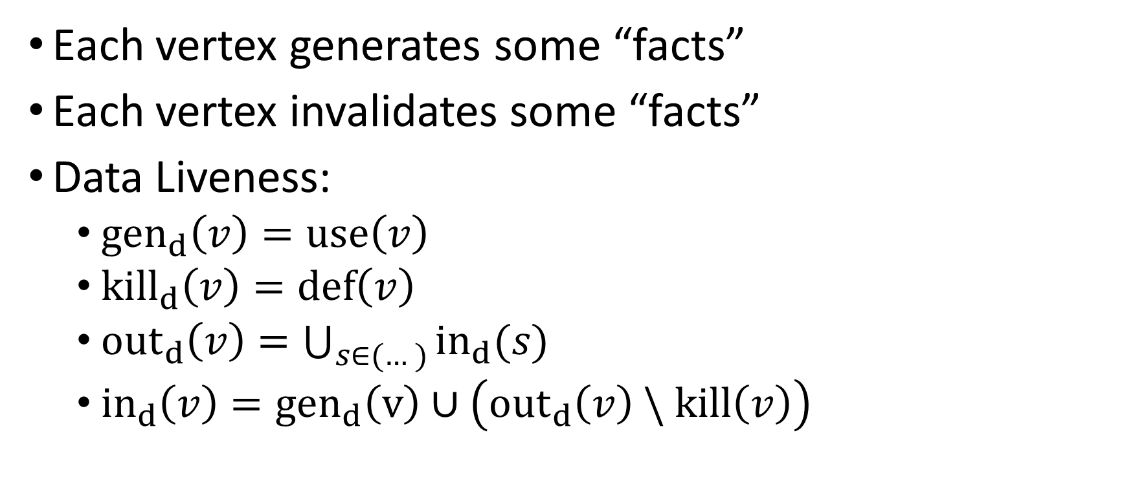
Another Description: Data Liveness
Each vertex generates some “facts”
Each vertex invalidates some “facts”
Data Liveness:
  $gen_{d}\left(v\right)=use\left(v\right)$
  $kill_{d}\left(v\right)=def\left(v\right)$
  ${out}_{d}\left(v\right)=\bigcup_{s∈(…)}{in_{d}(s)}$
  ${in}_{d}\left(v\right)={gen}_{d}\left(v\right)∪\left({out}_{d}\left(v\right) \backslash kill\left(v\right)\right)$
COMP 520: Compilers – S. Ali

Slide 69
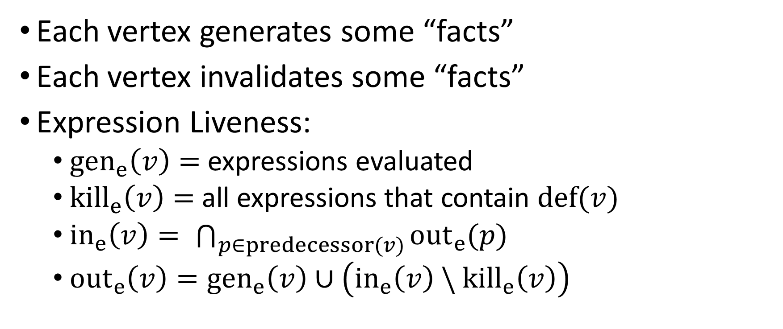
Formal Description: Expression Liveness
Each vertex generates some “facts”
Each vertex invalidates some “facts”
Expression Liveness:
  $gen_{e}\left(v\right)=$ expressions evaluated
  $kill_{e}\left(v\right)=$ all expressions that contain $def(v)$
  ${in}_{e}\left(v\right)= \bigcap_{p∈predecessor(v)}{{out}_{e}(p)}$
  ${out}_{e}\left(v\right)={gen}_{e}\left(v\right)∪\left({in}_{e}\left(v\right) \backslash {kill}_{e}\left(v\right)\right)$
COMP 520: Compilers – S. Ali

Slide 70
Termination in “Expression Liveness”
Only re-evaluate vertices when a predecessor has a change in the out set.
Will eventually reach a fixed-point.
COMP 520: Compilers – S. Ali

Slide 71
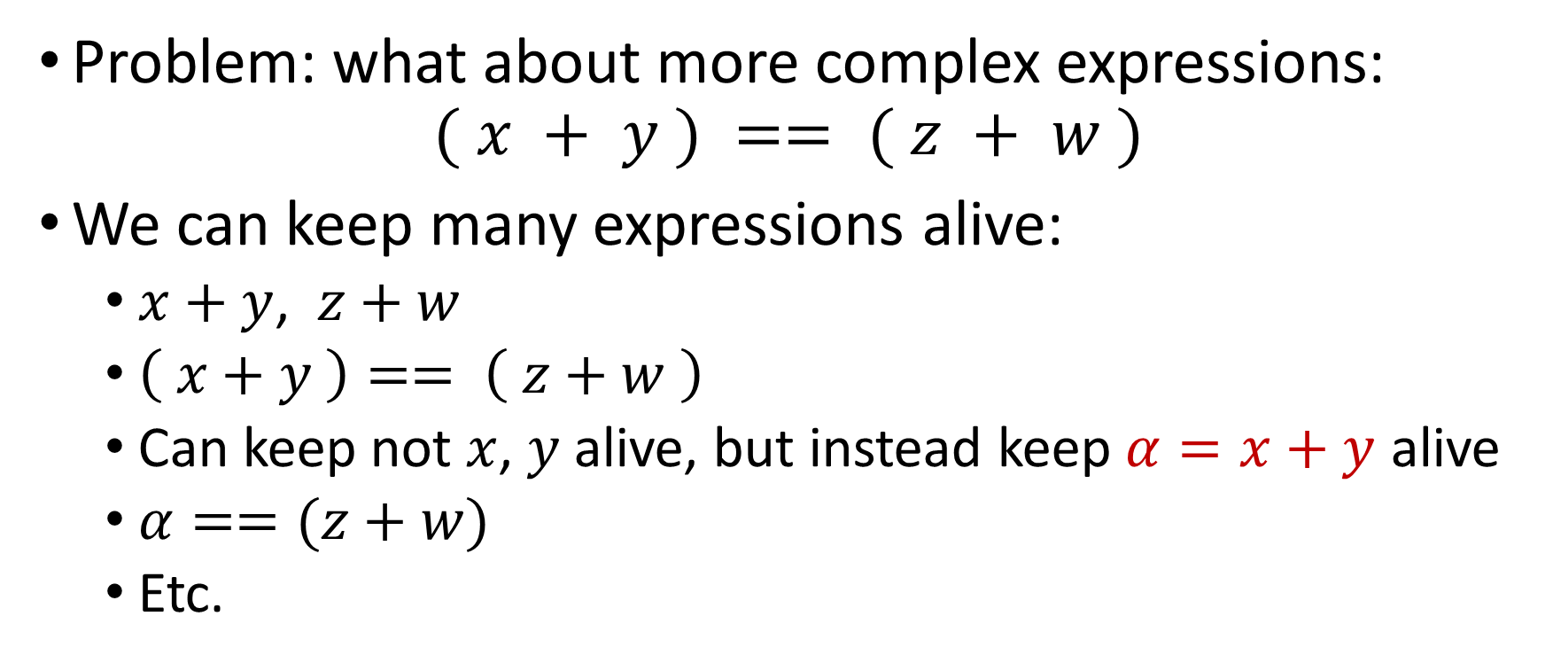
Not so simple…
Problem: what about more complex expressions:
$$( x + y ) == ( z + w )$$
We can keep many expressions alive:
  $x+y$, $z+w$
  $\left( x+y \right)== \left( z+w \right)$
  Can keep not $x$, $y$ alive, but instead keep $α=x+y$ alive
  $α==(z+w)$
  Etc.
COMP 520: Compilers – S. Ali

Slide 72

Idea: Break up vertices
Break every expression into small constituent components. Generate extra code!
“( x + y ) == ( z + w )” $⇒$ { x+y, z+w }
Original | Generate Code
c := (x+y) == (z+w) | a := x+y
 | b := z+w
d := z+w | c := (x+y)==(z+w)
 | d := z+w
return c+d
COMP 520: Compilers – S. Ali

Slide 73
Apply Expression Liveness Analysis
Replace expressions with aliased expressions
Original | Generate Code | Apply Aliases
c := (x+y) == (z+w) | a := x+y | a := x+y
 | b := z+w | b := z+w
d := z+w | c := (x+y)==(z+w) | c := a==b
 | d := z+w | d := b
return c+d
COMP 520: Compilers – S. Ali

Slide 74
Apply Data Liveness Analysis
Reuse variable names
Original | Generate Code | Apply Aliases | x | y | z | w | a | b | c | d | New Data Aliases
c := (x+y) == (z+w) | a := x+y | a := x+y
 | b := z+w | b := z+w
d := z+w | c := (x+y)==(z+w) | c := a==b
 | d := z+w | d := b
return c+d
COMP 520: Compilers – S. Ali

Slide 75
Apply Data Liveness Analysis
Can eliminate redundant operations
Original | Generate Code | Apply Aliases | x | y | z | w | a | b | c | d | New Data Aliases
c := (x+y) == (z+w) | a := x+y | a := x+y |  |  |  |  |  |  |  |  | x := x+y
 | b := z+w | b := z+w |  |  |  |  |  |  |  |  | y := z+w
d := z+w | c := (x+y)==(z+w) | c := a==b |  |  |  |  |  |  |  |  | x := x==y
 | d := z+w | d := b |  |  |  |  |  |  |  |  | y := y
x
y
z
w
x
y
x
y
return c+d
x := x+y
ret x
COMP 520: Compilers – S. Ali

Slide 76
Review
Data Liveness Analysis:
  Reduces the amount of data you need in memory at any given time
  Somewhat related to minimizing register usage (minimizing
  registers can be done after data+expression liveness)
Expression Liveness Analysis:
  Can eliminate the need to re-process expressions
Combined:
  They can eliminate instructions and reduce memory consumption.
COMP 520: Compilers – S. Ali

Slide 77
More Optimization?
Statements | # live
x := x+y | 4 (x,y,z,w)
y := z+w | 4 (x,y,z,w)
x := x==y | 2 (x,y)
x := x+y | 2 (x,y)
ret x | 1 (x)
Does that mean we
need 4 registers?
COMP 520: Compilers – S. Ali

Slide 78
More Optimization?
Does that mean we
need 4 registers?
Nope! More optimization possible
that will be related to the target
architecture.
Statements | # live
x := x+y | 4 (x,y,z,w)
y := z+w | 4 (x,y,z,w)
x := x==y | 2 (x,y)
x := x+y | 2 (x,y)
ret x | 1 (x)
COMP 520: Compilers – S. Ali

Slide 79
Register Minimalization is not
Dataflow/Expression Analysis
Statements | # live | X64 | # live
x := x+y | 4 (x,y,z,w) | mov rax,[x] | 1 (rax)
 |  | add rax,[y] | 1 (rax)
y := z+w | 4 (x,y,z,w) | mov rcx,[z] | 2 (rax,rcx)
 |  | add rcx,[w] | 2 (rax,rcx)
x := x==y | 2 (x,y) | cmp rax,rcx | 2 (rax,rcx)
 |  | xor rax,rax | 2 (rax,rcx)
 |  | sete al | 2 (rax,rcx)
x := x+y | 2 (x,y) | add rax,rcx | 2 (rax,rcx)
ret x | 1 (x) | ret | 1 (rax)
Only needed two registers.
Why? Because x64 can do “load memory” operations inside of instructions!
COMP 520: Compilers – S. Ali

Slide 80
See You Thursday!
Intel C Compiler mini-case study.
Generating multiple code paths.
Rewriting user code to apply exotic optimizations.
Remember, start PA4, some content from PA4 will be tested on Midterm 2.
COMP 520: Compilers – S. Ali

Slide 81
End

Slide 82
COMP 520: Compilers – S. Ali

Slide 83
COMP 520: Compilers – S. Ali

Slide 84
COMP 520: Compilers – S. Ali

Slide 85
COMP 520: Compilers – S. Ali

